Slide 1
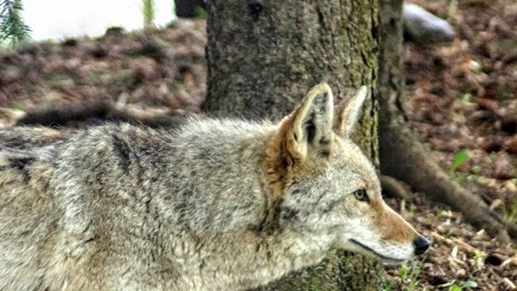
Identifying Wildlife Species in Florida

Slide 2
Mammals

Slide 3
Terrestrial Megafauna
Megafauna tend to be reclusive.
You are more likely to find tracks, scat, or markings left behind.
To identify the animals, use binoculars and maintain a distance to prevent the animals from being spooked.
The most common place to view megafauna are in Flatwoods, which have an understory dominated by saw palmettos and provide a high calorie food source.
The best times to see them are dusk and dawn.

Slide 4
Marine Mammals
Marine mammals are rare in Florida.
The most common are manatees and bottlenose dolphins.
To identify them, look for dorsal fins or the emergence of a head when they breathe at the surface.
Manatees create a spherical ripple on the surface of the water from their tail.

Slide 5
Small Mammals
Small mammals are more common than megafauna.
Bats can be seen flying from sunset to sunrise but rarely remain still long enough to properly identify. However, a camera with a fast shutter speed helps.
Smaller mammals can be seen running along the sides of buildings, feeding in denser regions with visible protection, and are more easily seen in urban areas where they have adapted alongside humans.
Some examples of urban mammals include mice, rats, opossums, and raccoons.

Slide 6
Birds

Slide 7
Large Birds
Large birds can be seen throughout Florida.
They are common along shores, freshwater marshes, saltwater marshes, and sandhills.
Some large birds such as osprey and sandhill cranes are frequently seen in urban areas.
Most large birds are accustomed to human presence, but some are more reclusive, such as owls. To identify more reclusive birds, it's best to listen for sounds.

Slide 8
Small Birds
These birds are fast and unless they have become habituated to bird feeders, they will keep a safe distance.
Having binoculars is helpful when observing them.
Listening for birdsongs can also help identify them.
Some small birds, such as warblers, are difficult to distinguish from each other. It's always good to have a camera and field guide when identifying small birds.

Slide 9
Reptiles

Slide 10
Testudines
Testudines in Florida include the gopher tortoise, freshwater turtles, and sea turtles.
Gopher tortoises are the only terrestrial testudines and can be seen in areas with sandy soil. They have back legs that look like elephant feet.
Freshwater tortoises are very common and can be seen in almost every retention pond, lake, river, or any freshwater region. They are distinguished by their webbed feet with claws.
Sea turtles can be observed during diving excursions near reefs but otherwise are only seen when females come to shore to lay their eggs from June to September. Sea turtles have paddle-like flippers without claws.

Slide 11
Lizards
Florida has several species of lizards but not all are native.
Skinks and anoles are extremely common and can be seen in almost every area of the state.
Iguanas can be seen in dense populations in south Florida all the way down to the Florida Keys. They are not fearful of humans and in the winter, falling iguanas pose a safety hazard.
Other non-native species, such as Northern curly-tailed lizards and Peter's rock agamas, are more reclusive and are sparsely found throughout the state and have adapted well to urban areas.

Slide 12
Snakes
Most snakes are reclusive.
When looking for snakes, look for glossy patterns in a landscape.
You may also keep a watch for any movement.
Snakes tend to remain still to avoid being seen by predators. For this reason, it's always good to have a walking stick on hand to poke the ground ahead of you.

Slide 13
Amphibians

Slide 14
All amphibians
To observe amphibians, you will need to be near a water source, caves in north Florida, bird baths, or where soils are wet with debris.
Look for motion around the wetlands or damp regions.
Some amphibians, such as frogs, can be identified by the sounds they make.
If looking for salamanders in caves, use a red light and look for motion.

Slide 15
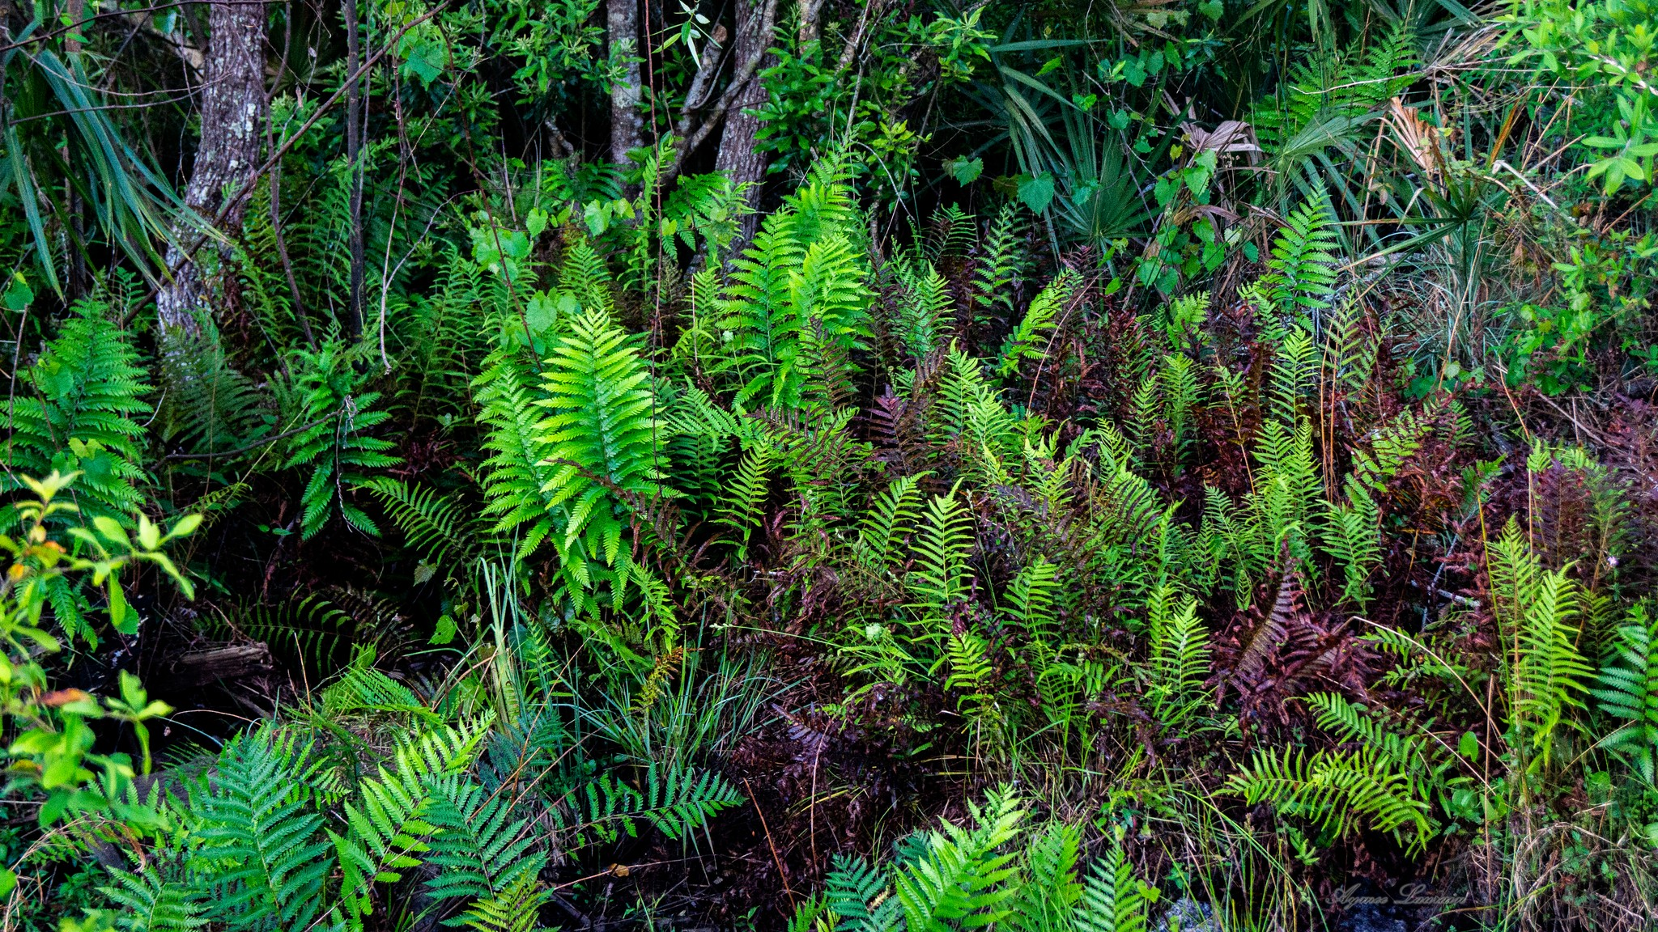
Have Fun Looking for Wildlife!

